Slide 1
March/9 Update
One little thing:
When we calculate joint velocity and acceleration, the data set will shorten 1 and 2.
What we used to do is trim the size of joint angle and velocity same as acceleration.
This will result in starting and end not match, a jump start at new stride, passive force can’t close loop.
Notes:
Blue is new data set, red is trimmed

Slide 2
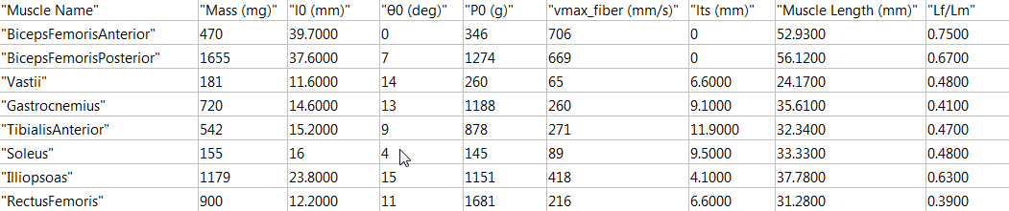
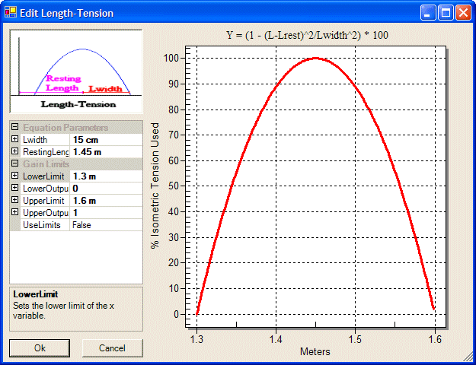
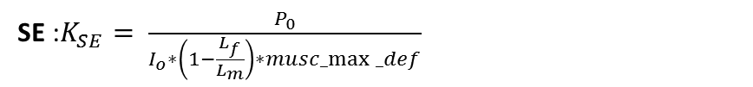


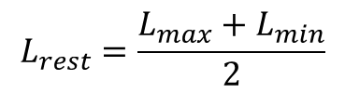



Muscle Parameters Revised
$$L_{rest}=\frac{L_{max}+L_{min}}{2}$$
$$L_{width}=L_{max}−L_{min}$$
Damping : $b= \frac{{1.25P}_{0}}{{v+v}_{max/4}}=\frac{{1.25P}_{0}}{v_{max/4}}$ (linear damping)
$T\left(l\right)∈ \left[0.75, 1\right]$ Passive force included
From Hill’s 1938 & Freivalds 2011
$musc_max⁡_def=0.04$ (Winter(1990) and Meijer (1998)
SE :$K_{SE}= \frac{P_{0}}{I_{o}∗\left(1−\frac{L_{f}}{L_{m}}\right)∗musc_max⁡_def}$
From ‘quick release’ method, apply a force as Po, the defection will be the shortening length of tendon. (Winter 1990, Wilkie 1956)
PE :$K_{PE}= \frac{{K_{SE}∗P}_{0}}{{K_{SE}∗L}_{m}∗musc_max⁡_def−P_{o}}$
From $F_{max}= \frac{K_{SE}∗K_{PE}}{K_{SE}+K_{PE}}∗∆x$

Slide 3
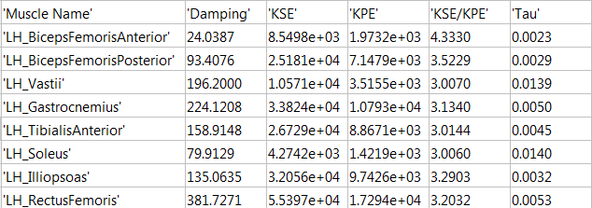
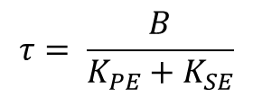
Sanity Check and Passive Tension
Reasonable Kse/Kpe ratio range around 3-4
(Evaluate from multiple reference.)
Active force build up and stress relaxation time constant tau range from 10.3 ms (Bawa 1976) to 47.6 ms (Wilke 1958)
$$τ= \frac{B}{K_{PE}+K_{SE}}$$

Slide 4
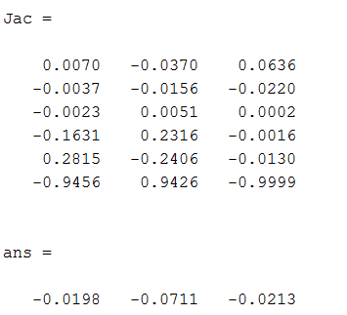
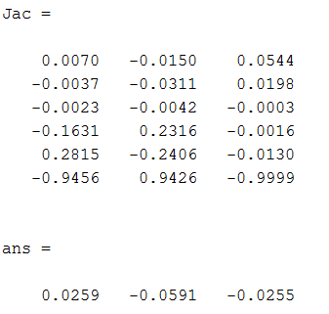
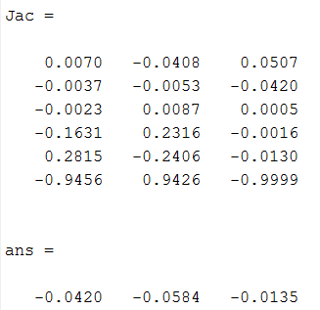

Spatial Manipulate Jacobian
$$J\left(θ\right)=\left[\begin{matrix}−w_{1}×q_{1} & −w_{2}×q_{2} & −w_{3}×q_{3} \\ w_{1} & w_{2} & w_{3}\end{matrix}\right]$$
Neutral Position
Start of Swing Phase
Start of Stance Phase

